Slide 1
Chapter 10: Appendix
v1.0, 10 December 2022 | EM-121011
For Healthcare Professionals only
Developed under the mentorship of the Asian Organization for Crohn's & Colitis
Supported by Janssen Asia Pacific, a division of Johnson and Johnson International (Singapore) Pte. Ltd. Editorial development by Transform Medical Communications, New Zealand
© Janssen Asia Pacific, a division of Johnson & Johnson International (Singapore) Pte. Ltd.

Slide 2
About IUS Primer module
IUS Primer module was created for training gastroenterologists in Asia on adopting Intestinal Ultrasound (IUS) for the diagnosis and management of Inflammatory Bowel Disease
Transform Medical Communications was commissioned by Janssen Asia Pacific for the development of this educational module under the guidance of IUS Primer working group members and AOCC. The division of Janssen responsible for developing the module is from medical education that follows strict non-promotional and educational guidance.
The development of the module was funded by Janssen Asia Pacific, a division of Johnson and Johnson International (Singapore) Pte. Ltd. in 2022. Non-commercial use of this module is permitted without any further permission, provided credit for the content is clearly attributed to Janssen Asia Pacific.
AOCC: Asian Organization for Crohn's & Colitis; IUS: Intestinal ultrasound.

Slide 3
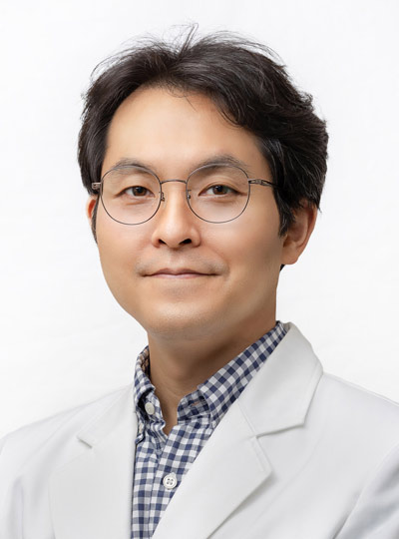
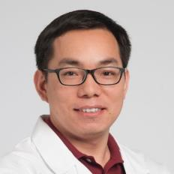
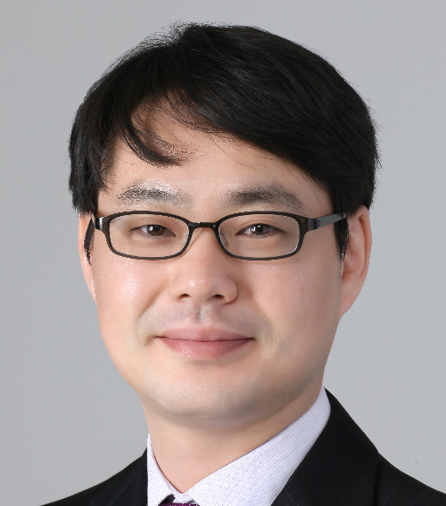
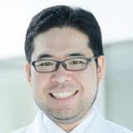
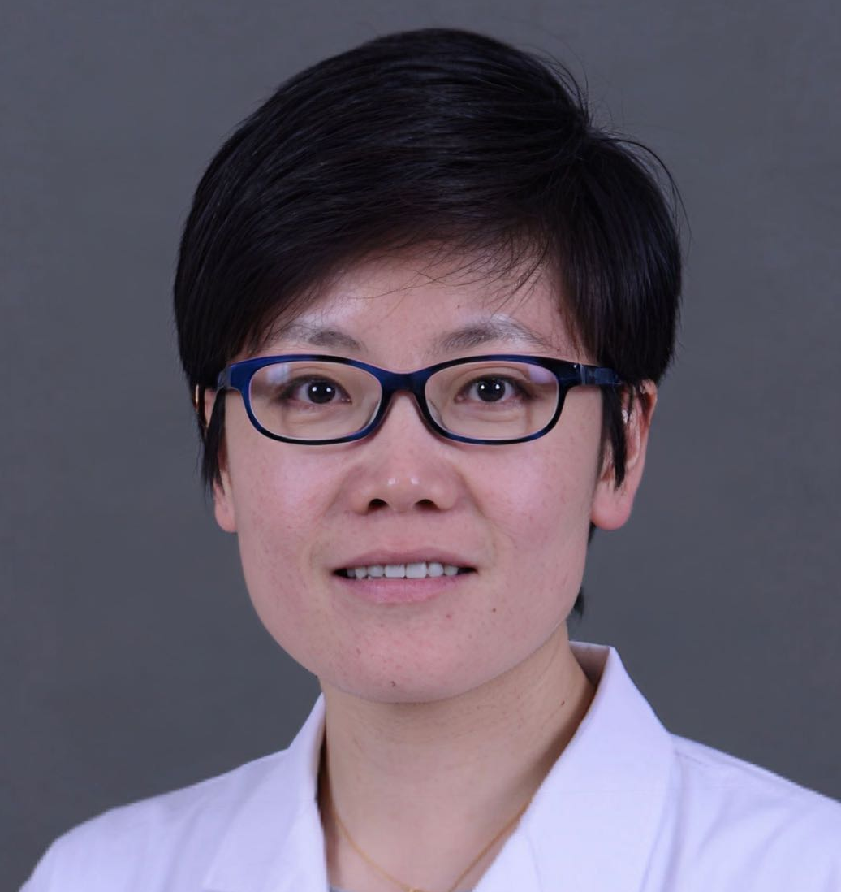
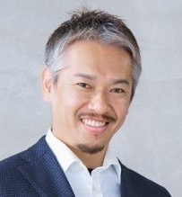
Special thanks to IUS Primer AOCC working group members
Prof. Eun Soo KIM
A/Prof. Ren MAO
Kyungpook National University
First Affiliated Hospital of Sun Yat-sen University
KOREA
CHINA
Prof. Chang Kyun LEE
A/Prof. Jun MIYOSHI
Kyung Hee University
Kyorin University
KOREA
JAPAN
Prof. Yue LI
Dr. Shintaro SAGAMI
Peking Union Medical College Hospital
Kitasato University Kitasato Institute Hospital
CHINA
JAPAN
AOCC: Asian Organization for Crohn's & Colitis; IUS: Intestinal ultrasound; WG: working group.

Slide 4
Sample reporting form for IUS
Name: Age/Sex: Referring Doctor: | Investigation: Intestinal ultrasonography (IUS) Date: Gastroenterologist/ radiologist: | Investigation: Intestinal ultrasonography (IUS) Date: Gastroenterologist/ radiologist:
Clinical information & summary of findings from previous IUS exam:
Pathologic segment(s): Jejunum/ proximal and mid ileum/ distal ileum/ terminal ileum/ Cecum/ right colon/ left colon
Maximum bowel wall thickness (BWT) | mm
Bowel wall stratification (BWS) | Preserved / Uncertain/ Lost
Vascularization with colour Doppler and Limberg score | _____________ Limberg score:
Motility | Normal/ Decreased/ Increased
Mesentery (fibrofatty proliferation/ fat wrapping) | No/ Yes
Presence of free fluid | No/ Yes
Enlarged mesenteric lymph nodes | No/ Yes
Complications (strictures, fistula, abscess, inflammatory mass) | No/ Yes. Further details:
Other findings | _____________ ______________________________________________
Summary of findings | _______________________________________________________
Diagnosis | _______________________________________________________
Collated from: Jauregui-Amezaga, A., & Rimola, J. (2021). Life, 11(7), 603; Atkinson, N. S., et al. (2017). World journal of gastroenterology, 23(38), 6931; El-Nakeep S, Pozun A.(2022) [Internet] Available at: https://www.ncbi.nlm.nih.gov/books/NBK570568/
BWT: bowel wall thickness; BWS: bowel wall stratification; IUS: intestinal ultrasonography
Notes:
Jauregui-Amezaga, A., & Rimola, J. (2021). Life, 11(7), 603.
Atkinson, N. S., et al. (2017). World journal of gastroenterology, 23(38), 6931.

Slide 5
Other resources – videos and webinars
Advancements in Testing and Diagnosis for IBD. [Crohn's and Colitis Canada], Dec 11, 2019. Available at: https://www.youtube.com/watch?v=nsx_sFprtF0&list=PLvx9WjkKbU4M24gqY99H9Zy54ms9X-FYn&t=795s
Bowel Ultrasound in Inflammatory bowel disease Session on Bowel Ultrasound. [Vishal Sharma, PGI IBD update], Mar 21, 2021. Available at: https://youtu.be/oO50ERN13nU
Webinar on Gastrointestinal ultrasound (GIUS). European Federation of Societies for Ultrasound in Medicine and Biology, June 11, 2020. Available at: https://efsumb.org/gastrointestinal-ultrasound-gius/

